Slide 1
Spatial Database

Slide 2
Spatial Database Concepts
Spatial databases support information about objects in multidimensional space
  Examples: cartographic databases, geographic information systems, weather information databases
Spatial relationships among the objects are important
Optimized to query data such as points, lines, and polygons
  Spatial queries

Slide 3
Spatial Database Concepts (cont’d.)
Measurement operations
  Used to measure global properties of single objects
Spatial analysis operations
  Uncover spatial relationships within and among mapped data layers
Flow analysis operations
  Help determine shortest path between two points

Slide 4
Spatial Database Concepts (cont’d.)
Location analysis
  Determine whether given set of points and lines lie within a given polygon
Digital terrain analysis
  Used to build three-dimensional models

Slide 5
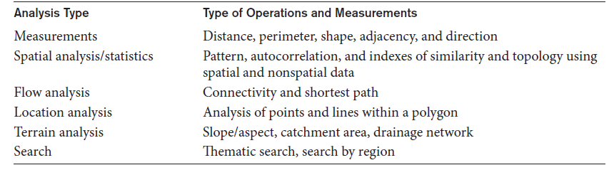
Spatial Database Concepts (cont’d.)
Common types of analysis for spatial data

Slide 6
Spatial Database Concepts (cont’d.)
Spatial data types
  Map data
    Geographic or spatial features of objects in a map
  Attribute data
    Descriptive data associated with map features
  Image data
    Satellite images
Models of spatial information
  Field models
  Object models

Slide 7
Spatial Database Concepts (cont’d.)
Spatial operator categories
  Topological operators
    Properties do not change when topological transformations applied
  Projective operators
    Express concavity/convexity of objects
  Metric operators
    Specifically describe object’s geometry
  Dynamic spatial operators
    Create, destroy, and update

Slide 8
Spatial Database Concepts (cont’d.)
Spatial queries
  Range queries
    Example: find all hospitals with the Metropolitan Atlanta city area
  Nearest neighbor queries
    Example: find police car nearest location of a crime
  Spatial joins or overlays
    Example: find all homes within two miles of a lake

Slide 9
Spatial Database Concepts (cont’d.)
Spatial data indexing
  Grid files
  R-trees
  Spatial join index
Spatial data mining techniques
  Spatial classification
  Spatial association
  Spatial clustering

